Slide 1




SUSTech Store
11910831 刘季冬
11911336 谭雅静
11811323 魏丰麟
11912636 侯伊林
11912933 徐卓琳
2021.10.14

Slide 2


CONTENT
01
Mockups
03
Features&Timeline
02
Architecture
04
Techniques

Slide 3

1
Mockups

Slide 4

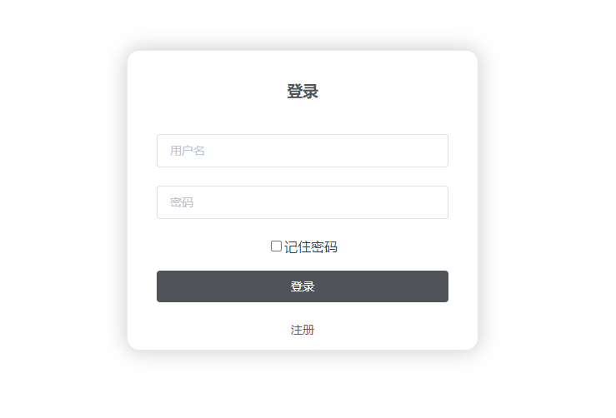

Login

Slide 5
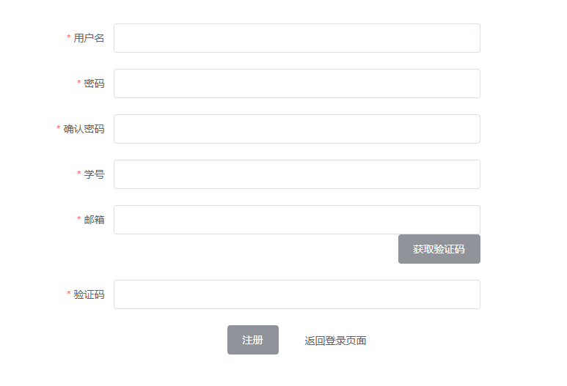
Register

Slide 6
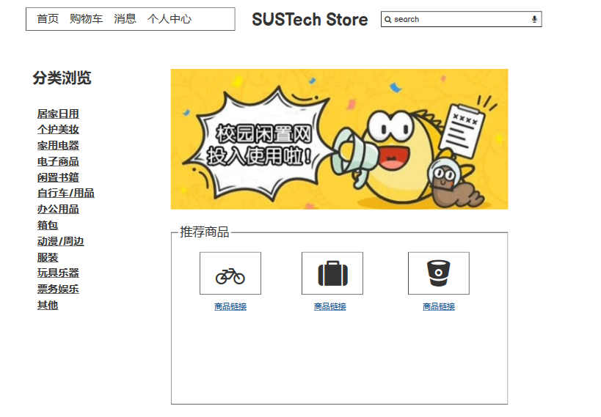
Homepage

Slide 7
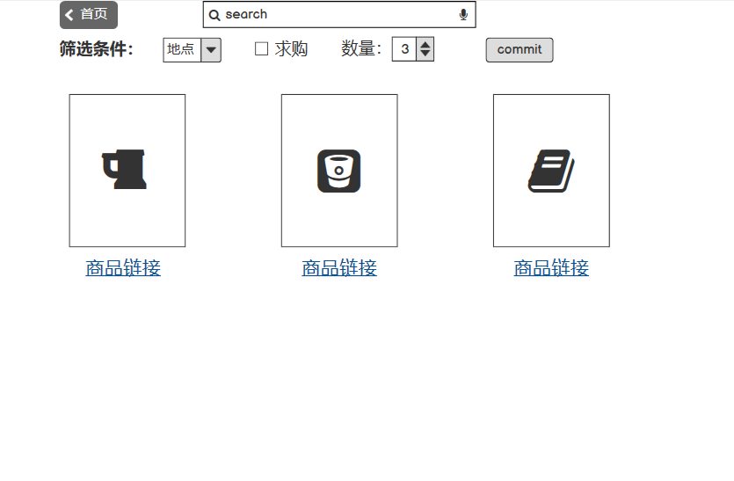
Searching Results

Slide 8
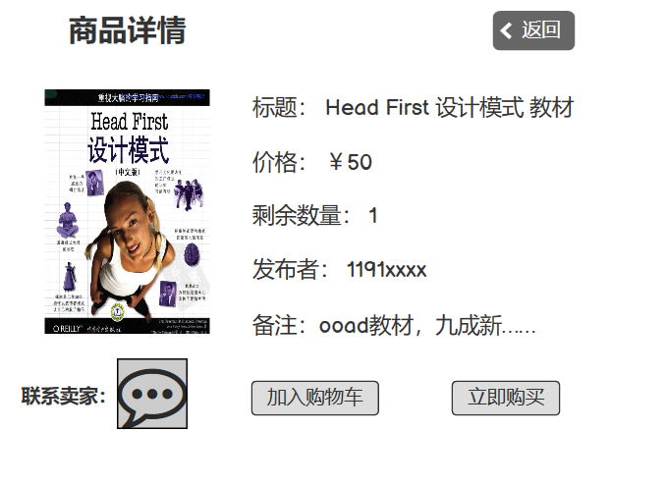
Description

Slide 9
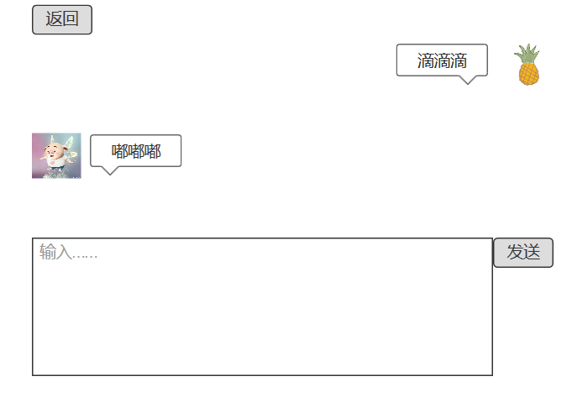
Chatting

Slide 10
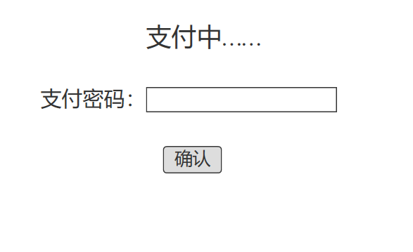
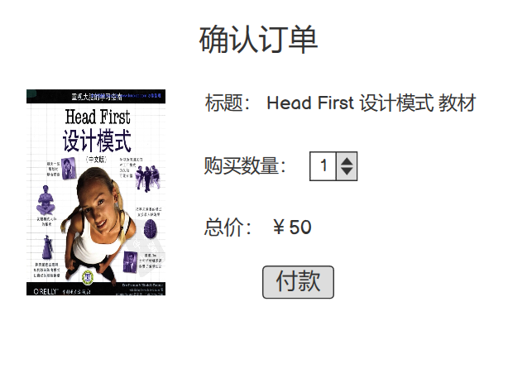
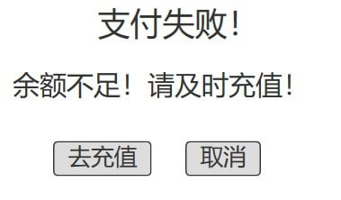
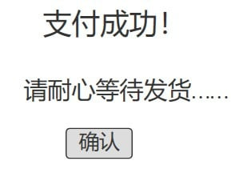
Confirm
余额不足
余额充足

Slide 11
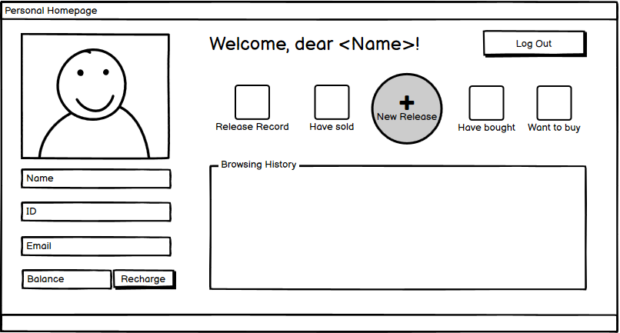
Personal Homepage

Slide 12
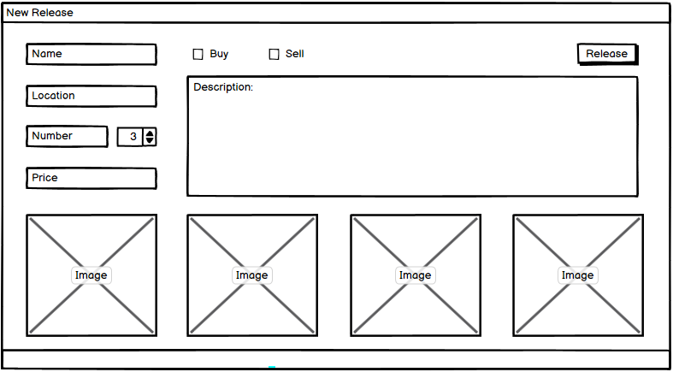
Release New Message

Slide 13
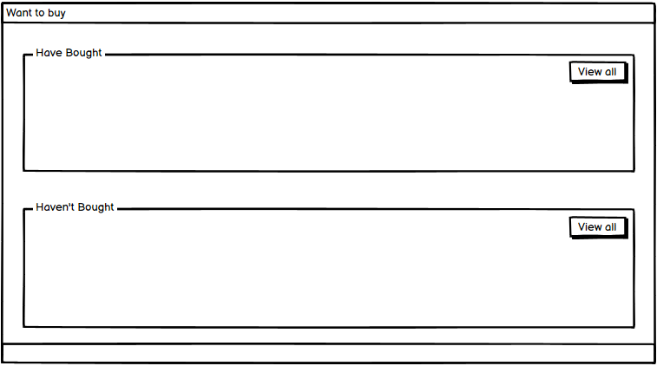
Want To Buy

Slide 14
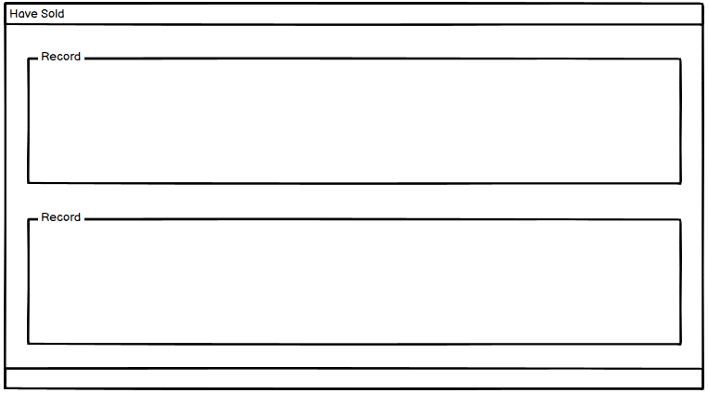
Records

Slide 15
2
Architecture

Slide 16
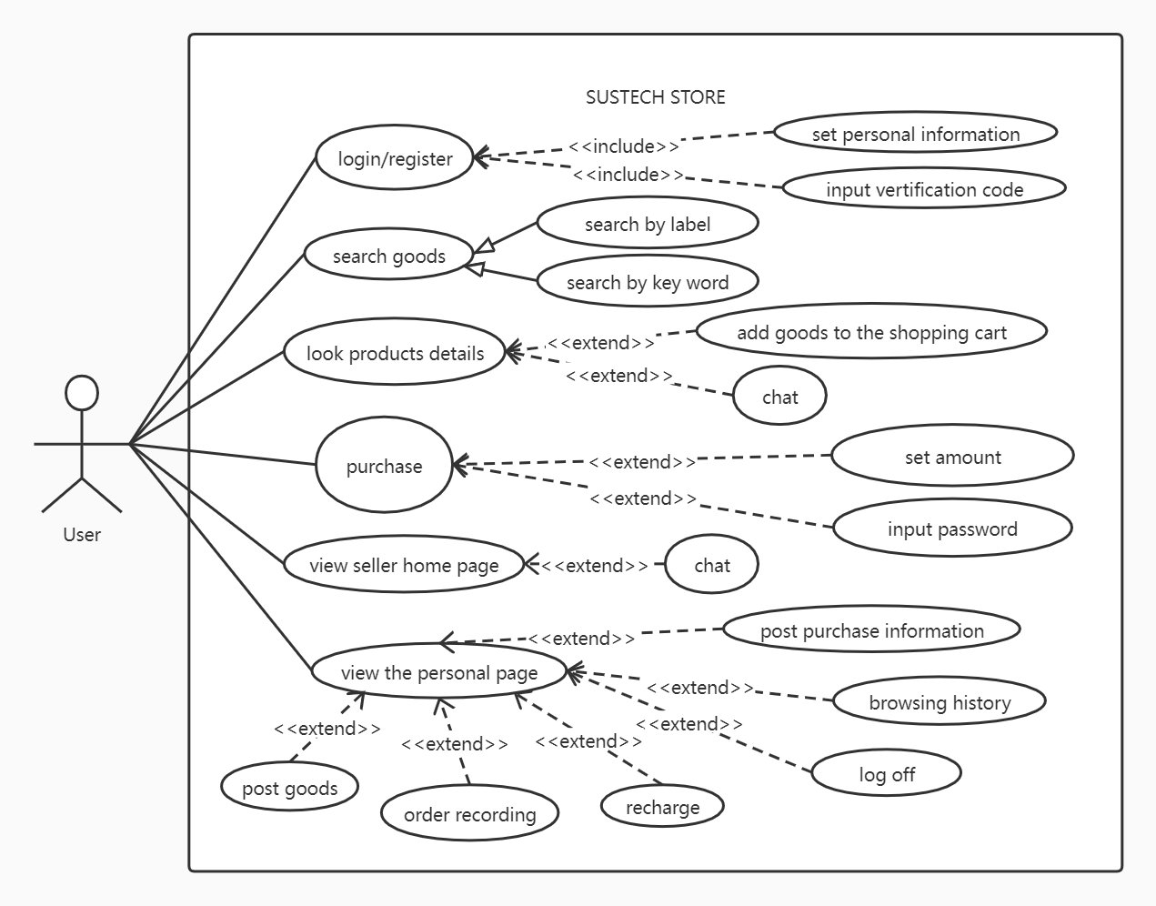
Use Case Diagram

Slide 17
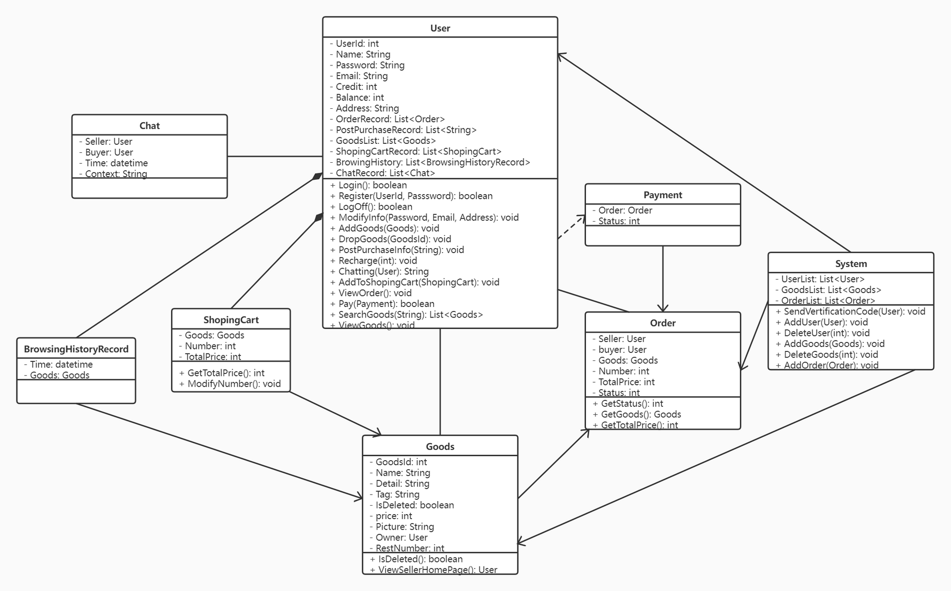
Class Diagram

Slide 18
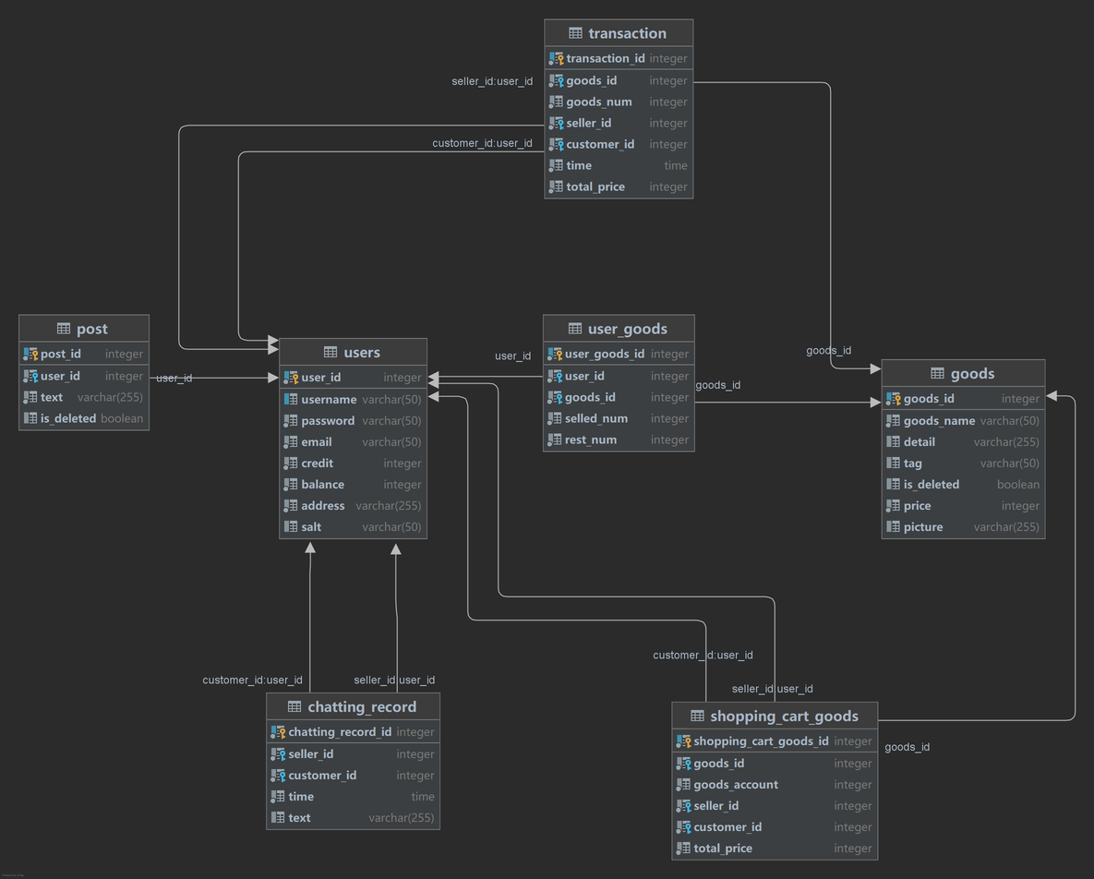
ER Diagram
Follow 3NF

Slide 19
Features
&
Timeline
3

Slide 20
Features
Basic Features:
Login/Register, Main Page, Personal Home Page, Search Box, Goods Details, Mail Reminder, （before November 15th） Chatting, Release and Post Goods, Transaction, Pay by Virtual Currency, Credit... (before Nov 30th)
Advanced Features(lower priority):
Seller Home Page, Shopping Cart, Browsing History, Recommending Goods (before Dec 20th)

Slide 21
4
Techniques

Slide 22
Techniques
Vue:
It is a set of progressive JavaScript frameworks for building user interfaces.
Spring Boot:
Spring is a lightweight container that manages the life cycle of beans. It provides powerful IOC, AOP and Web MVC functions. SpringBoot simplifies the initial setup and development of new Spring applications.

Slide 23
Techniques
Shiro:
Combine password with randomly generated salt and then hash to encode, store the encoded password and corresponding salt in database. Shiro is used to verify the input password when user log in.
Mail:
Java officially provides a Java class library that encapsulates the email protocol JavaMail. Enable THE SMTP protocol of QQ mailbox and record the activation code. Then use QQ mail to send email to user's email.

Slide 24
Thanks
2021.10.14

